Slide 1
Excel inc
MSBA Team D In Person
David Chen Lee, Jerry Yang, Himangini Banwari, Jessica Zhang, Michael Chung

Slide 2
Measures & Definitions
loyalty: loyal If all visits by user at same chain
loyalTo: the chain user is loyal to or “Not Loyal”
frequentShopper: if user shop > 2 visits in the year
closeToHome: whether the visit distance between venue and user location less than 5 miles (short/long distance)

Slide 3
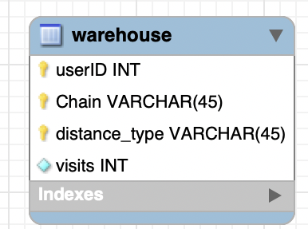
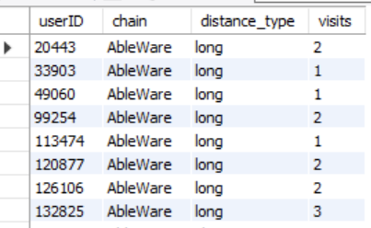
Data Warehouse Procedure
1 . Based on our ERM diagram, we were able to gather our information
2. Then we used engine FEDERATED to create our datahouse table on our local server

Slide 4
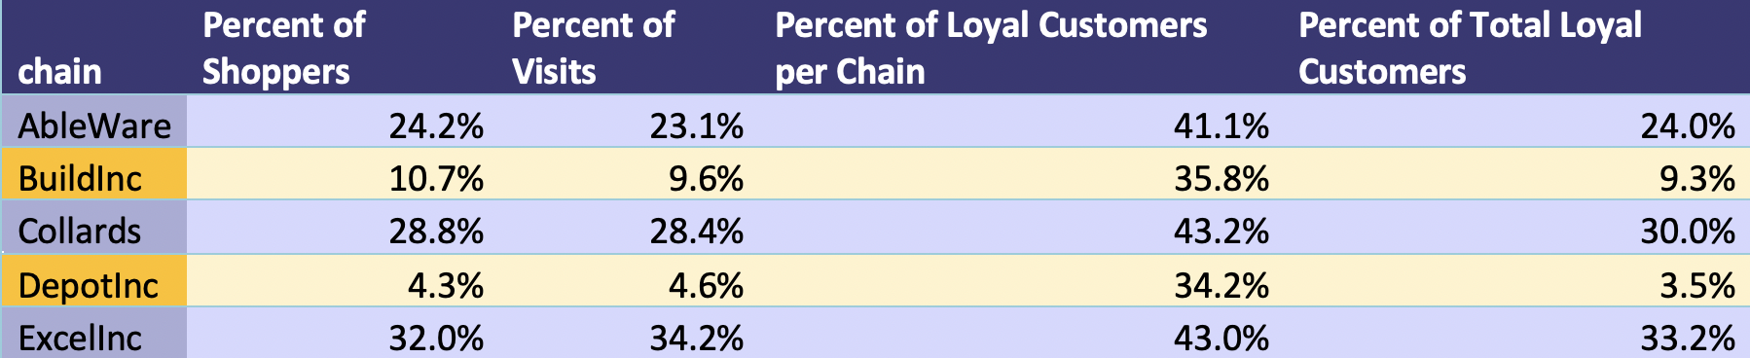
Overall Shopping Behaviors
Percentage of shoppers/visits:
Aggregate the customer and visits by chain and then divided by total shopper/visits
Percentage of loyal customer/Total loyal customer:
Aggregate the customers who only went to one chain in past year and divided by total shoppers in the chain/total loyal customers

Slide 5
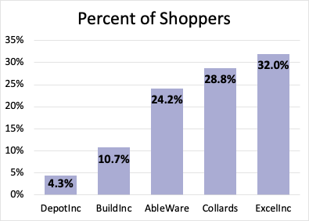
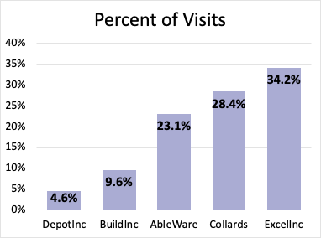
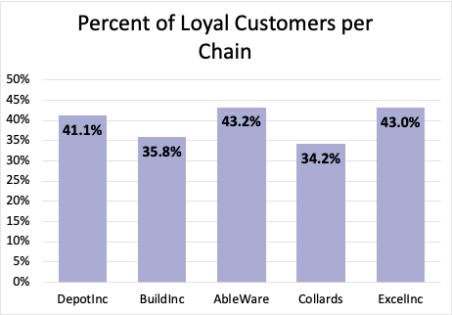
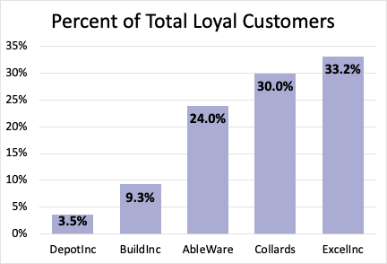

Slide 6
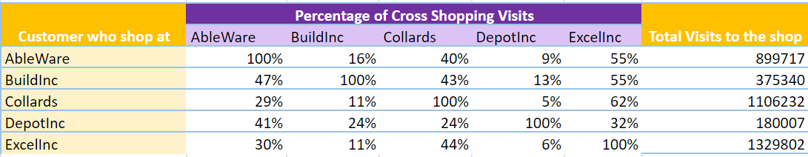
Cross-Shopping Behaviors
Cross Shopping Total Visits Table
Aggregate the visits by chain from the customers who shop in each chain and then divide by the visits in that specific chain from the chain’s customers

Slide 7
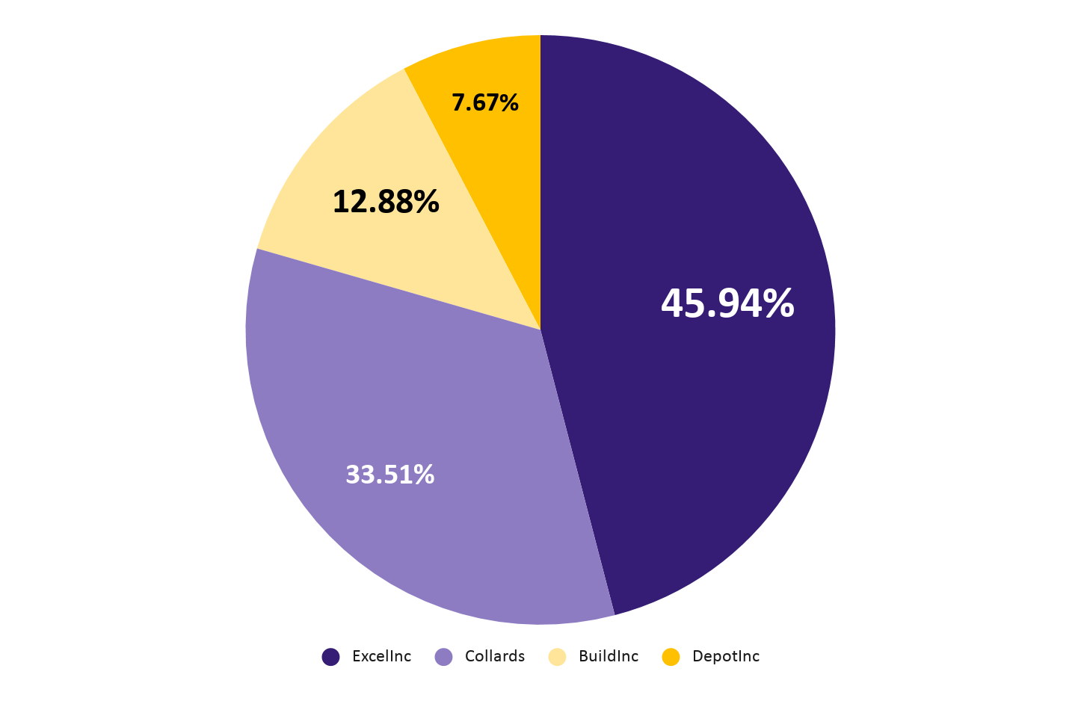
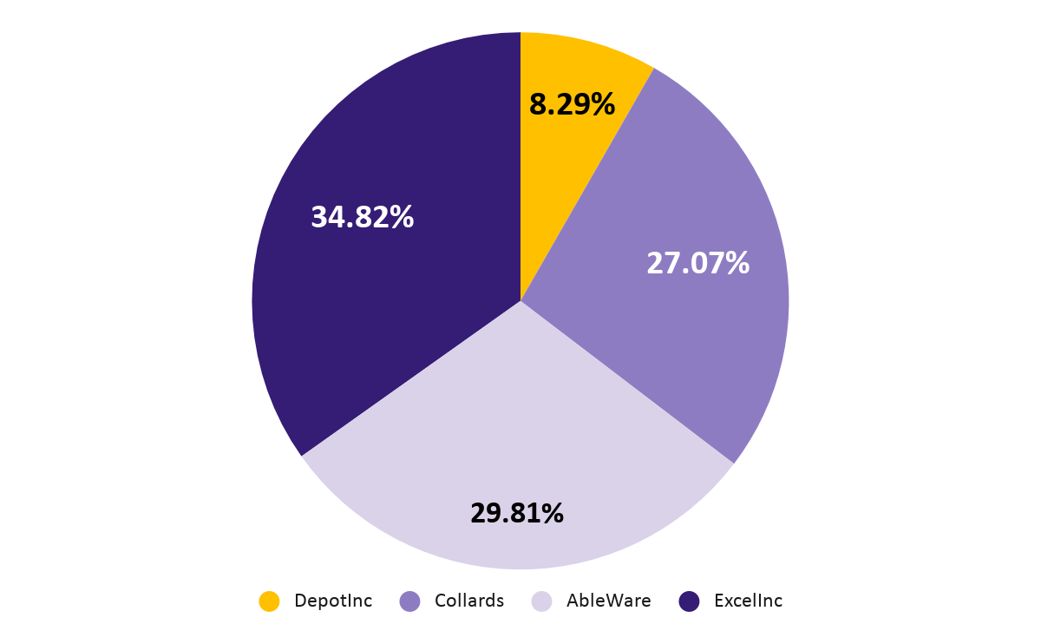
Retailers’ customers mostly cross shop at ExcelInc
AbleWare
BuildInc

Slide 8
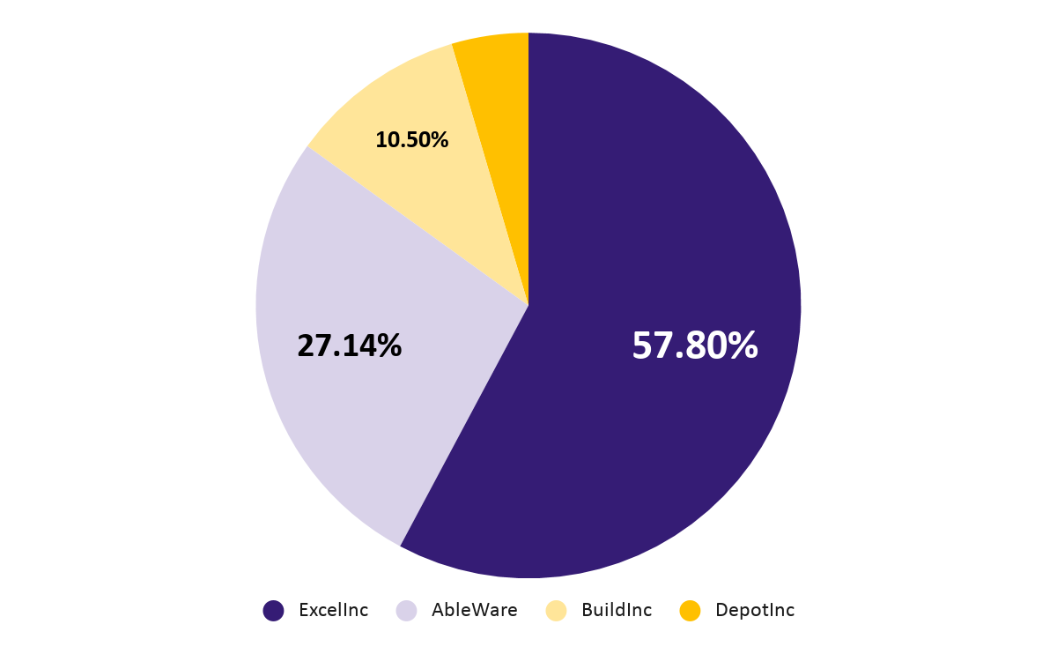
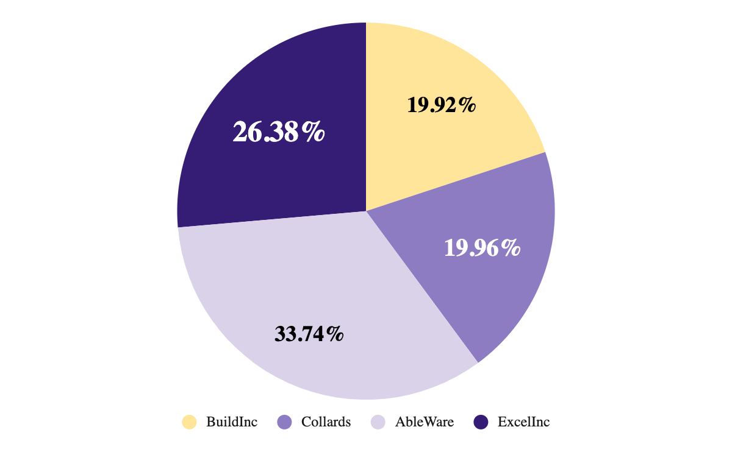
Retailers’ customers mostly cross shop at ExcelInc
Collards
DepotInc
4.55%

Slide 9
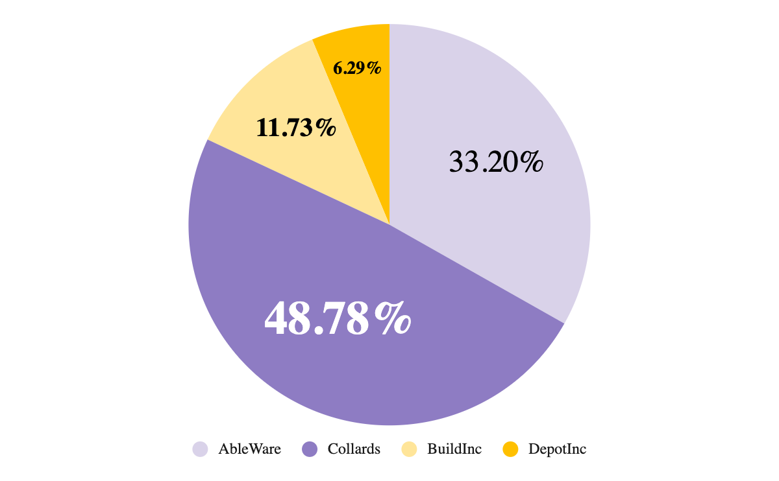
ExcelInc’s Biggest Competitors are Collards and AbleWare
ExcelInc

Slide 10
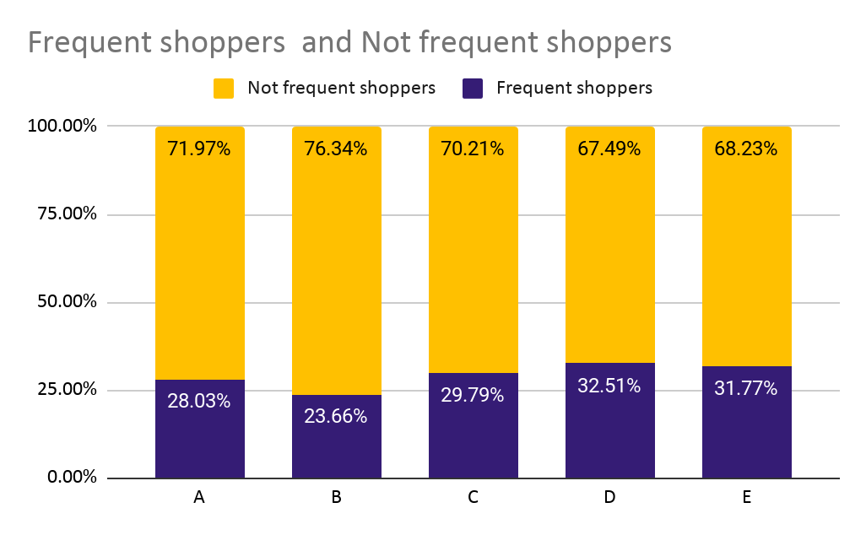
Segmentation of Frequency
Overall, for every store, the percentage of non frequent shoppers is larger than that of frequent shoppers. Among 5 chains, DepotInc has largest percentage of frequent shoppers while Buildinc has the smallest.
 | Frequent shoppers | Not frequent shoppers
A | 28.03% | 71.97%
B | 23.66% | 76.34%
C | 29.79% | 70.21%
D | 32.51% | 67.49%
E | 31.77% | 68.23%
Notes:
Thank you Mike for explaining the cross shopping bahvious. I am Jessica Zhang. And I am going to talk about our segmentation analysis.
For the frequency part, as we can see in the table and the graph, for all the chains, not frequent shoppers, which are around 70%, presented in the yellow bar, takes larger proportion. And among the 5 chians, D has the largest percentage of frequent shoppers while Buildinc has the smallest.

Slide 11
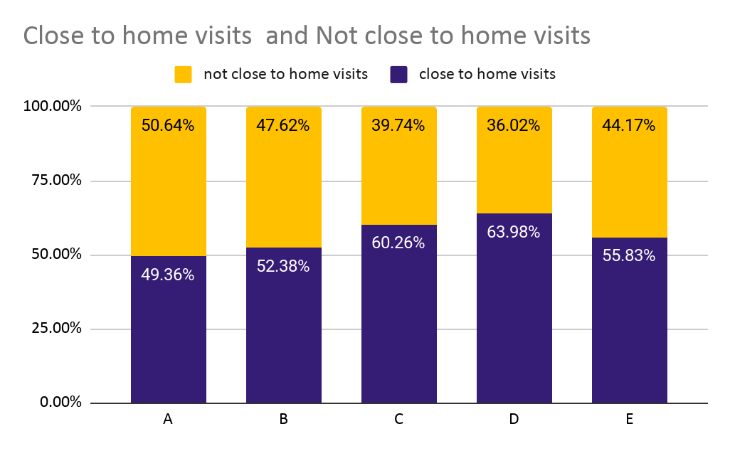
Segmentation of distance
Four of the chains have a larger percentage of close to home visits than not close to home visits.
Only Ableware has relatively higher percentage of not close to home visits, which corresponds to the analysis that Ableware has the largest percentage of loyal customers.
 | Close to home visits | Not close to home visits
A | 49.36% | 50.64%
B | 52.38% | 47.62%
C | 60.26% | 39.74%
D | 63.98% | 36.02%
E | 55.83% | 44.17%

Slide 12
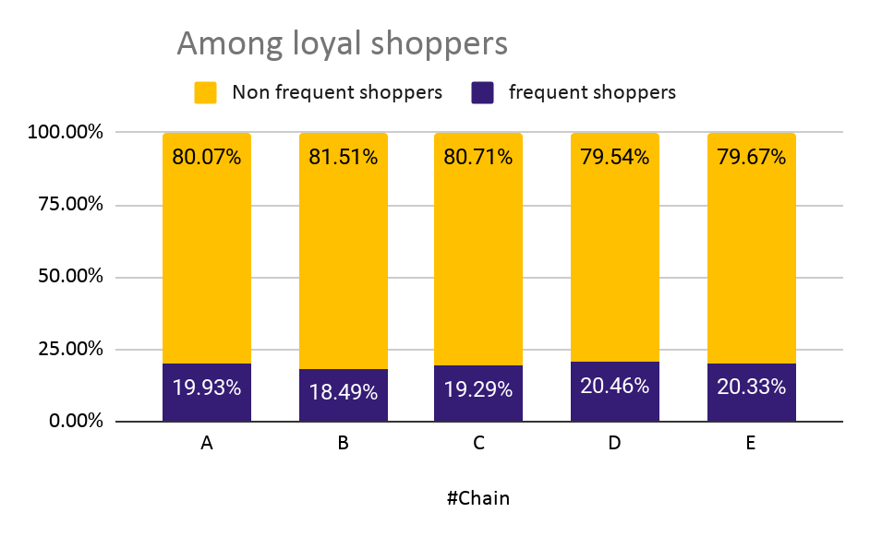
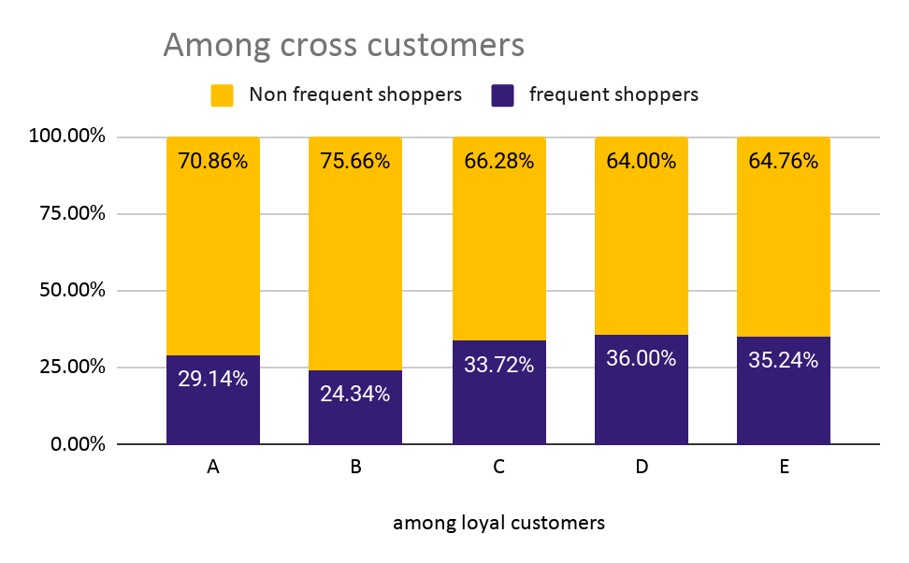
By not loyal and by frequent shoppers
Among loyal customers, most are non frequent shoppers.
Among cross shoppers, the percentage of frequent shoppers is higher although the portion of non frequent shoppers is still large.
 | among loyal customers |  | among cross customers
#Chain | frequent shoppers | Non frequent shoppers | frequent shoppers | Non frequent shoppers
A | 19.93% | 80.07% | 29.14% | 70.86%
B | 18.49% | 81.51% | 24.34% | 75.66%
C | 19.29% | 80.71% | 33.72% | 66.28%
D | 20.46% | 79.54% | 36.00% | 64.00%
E | 20.33% | 79.67% | 35.24% | 64.76%
Notes:
As the percentage of loyal shoppers and non loyal shoppers has been discussed in the overall shopping behaviour part, we are going to discuss about frequency behaviours in this segmentation part of loyalty.
So among the loyal customers, the percentage of not frequent shoppers for each chain, which are presented in the yellow bar in the first graph, are around 80%. Among cross shoppers, although the portion of non frequent shoppers is still large., as we can see in the yellow bar second graph, the percentage of frequent shoppers is higher.
Next, let David make summary of segmentation and an overall summary.

Slide 13
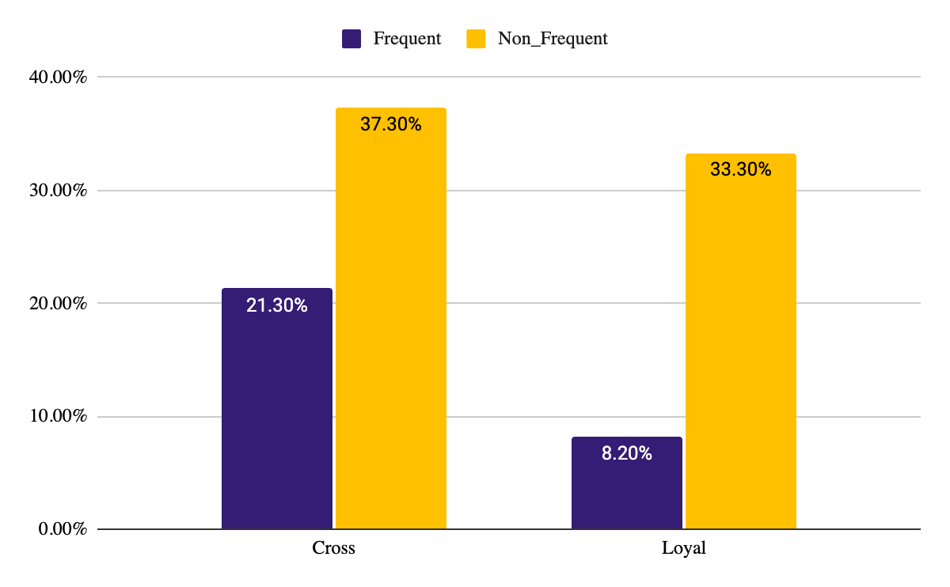
Segmentation summary
Most loyal shoppers tend to not be frequent customers
Cross shoppers are more likely to be frequent shoppers than loyal shoppers
 | Cross | Loyal
Frequent | 21.30% | 8.20%
Non Frequent | 37.30% | 33.30%

Slide 14
Summary
ExcelInc has highest portion of customers and visits
ExcelInc has highest porpotion of loyal customer
The main competitors for ExcelInc is Albleware and Collards
ExcelInc has around 55% of short visits
Loyal customers will have higher chance to be the non_frequent customers

